Slide 1
Week 6 – Topics
Debugging
Unit Testing / Mocking

Slide 2
Debugging

Slide 3
Debugging
Debugging can be described as diagnosing problems in code: finding what is causing a problem, and fixing those problems!
A bug in a program is something that causes the program to fail to do what it is designed to do.
The term debugging comes from taking bugs out of code, literally removing the bugs from a program.
The term debug is anecdotally attributed to U.S. Navy Rear Admiral Grace Hopper. The story is told that in 1945, she coined the term debug when she and her colleagues found a problem in Mark II computer, when they opened up the machine, they found and removed an actual moth. Although the term bug had been used since the 19th century to describe a mechanical malfunction, Grace Hopper was actually the first to use bug to talk about a computer problem, and to talk about debugging a computer.
https://github.com/ckiefriter1/Java-Code-Examples/blob/main/src/debugging/DebuggingExample.java

Slide 4
Using Debuggers like in Eclipse
Important vocabulary:
debugger: a computer program that helps find and correct errors in other computer programs.
breakpoint: a signal that informs the debugger to temporarily suspend execution of the program at a certain point in the code.
Integrated Development Environments (IDE) like Eclipse provide debuggers.
The following instructions will aid in the use of the Eclipse IDE debugger:
To define one or more breakpoints in your source code where you suspect the problem is happening. To set a breakpoint, right-click in the left margin when editing your code in Eclipse IDE, and select Toggle Breakpoint.
To run your Java code in debug-mode within the Eclipse IDE, choose:
Run --> Debug As --> Java Application
The Debug Perspective offers new views to allow better troubleshooting, including Debug View, Breakpoints View, Variables View, Expressions View, and more.
Definitely switch to the perspective to the Debug Perspective to take advantage of these different views.

Slide 5
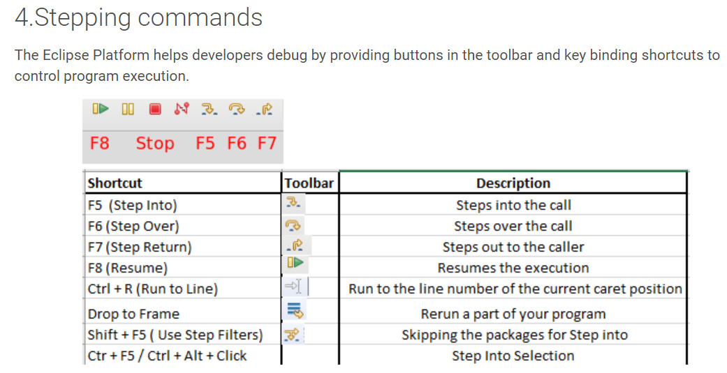
Using Debuggers like in Eclipse

Slide 6
Unit Tests

Slide 7
Unit Tests
Unit Testing is code you write that runs your application code to make sure the output is as expected.
Junit is a common framework used to build unit tests for code.
https://junit.org/junit5/docs/current/user-guide/#overview
https://github.com/ckiefriter1/Java-Code-Examples/tree/main/src/UnitTesting

Slide 8
Appendix

